Slide 1
UK Bank Customers' Balance Analysis
Represented By
Saumi Mukherjee

Slide 2
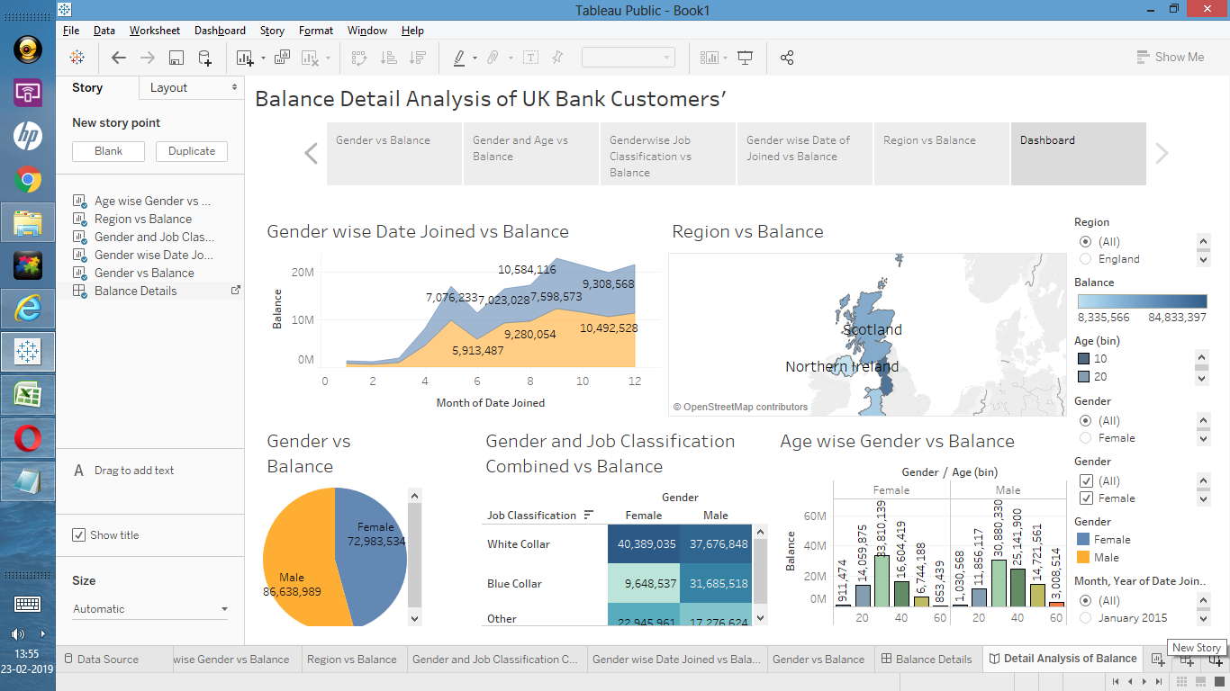
Story line(Dashboard)

Slide 3
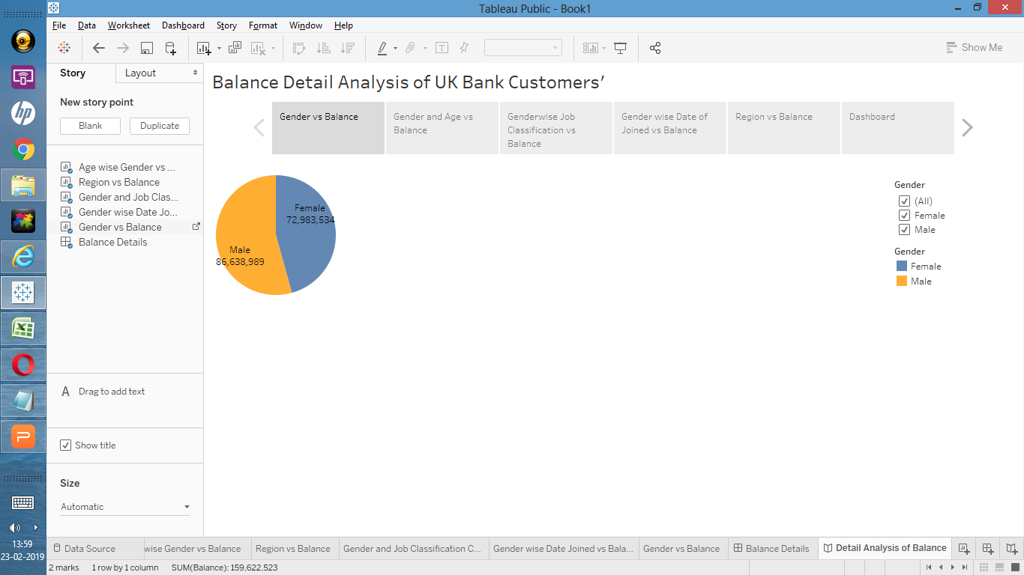
Story line(Gender vs Balance)

Slide 4
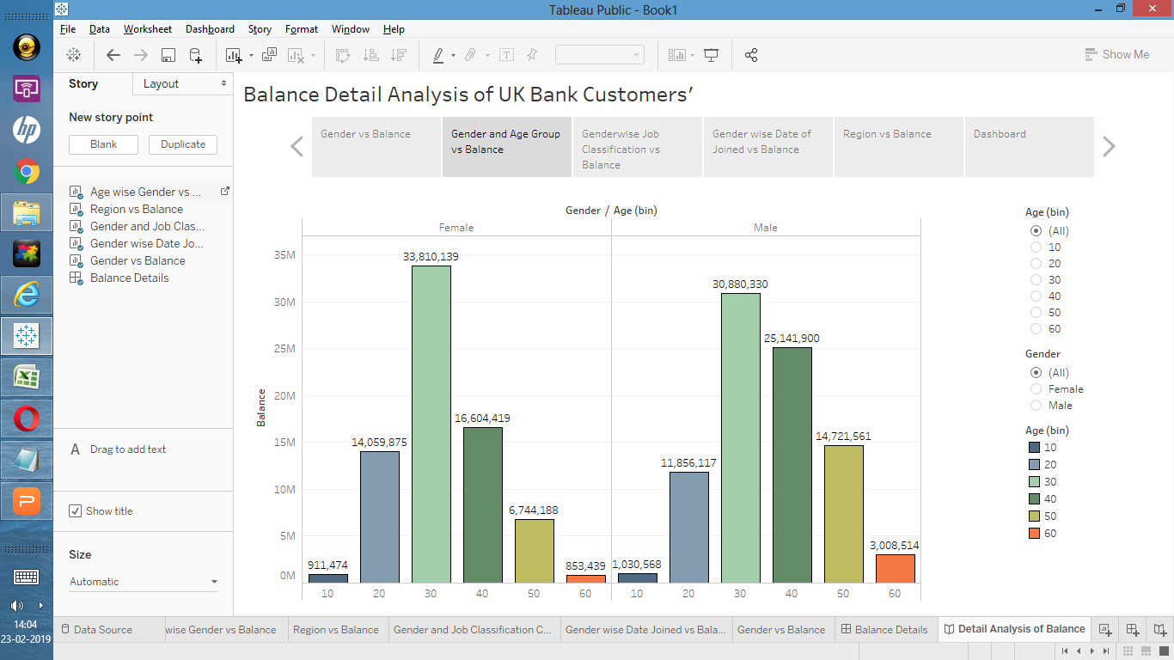
Story line(Gender and Age Group vs Balance)

Slide 5
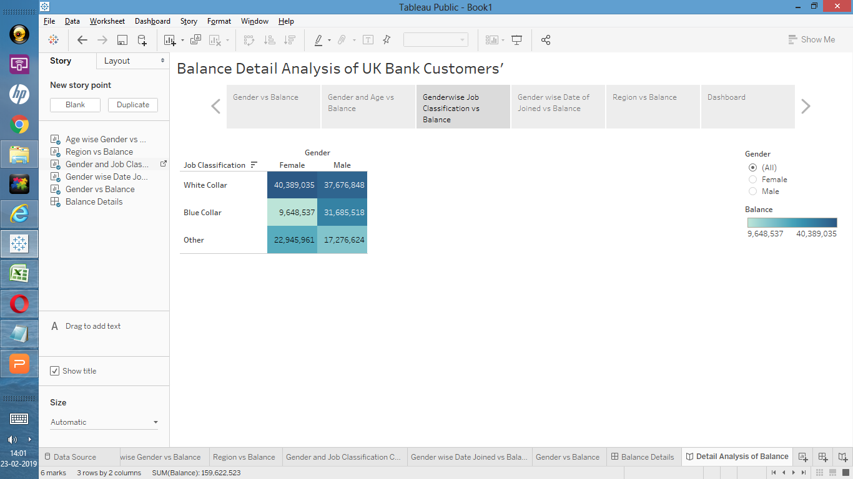
Story line(Genderwise Job Classification vs Balance)

Slide 6
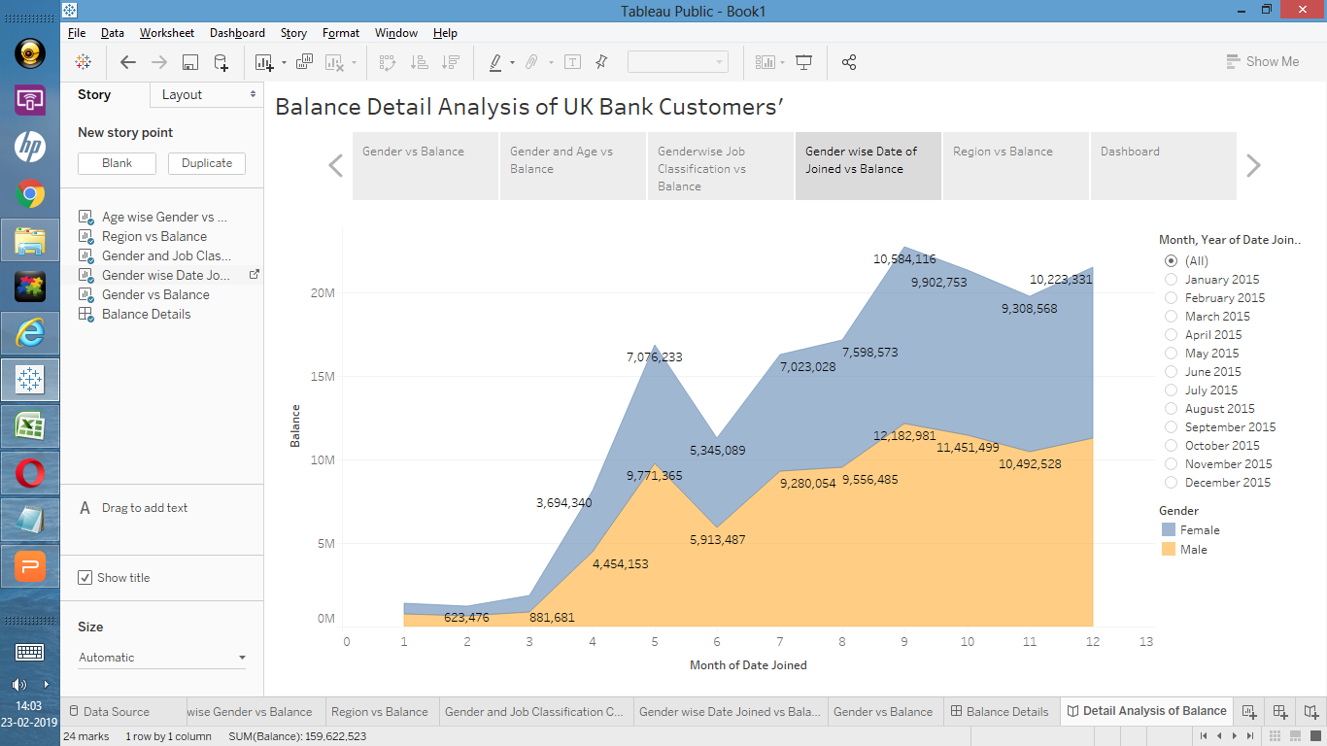
Story line(Gender wise Date of Joined vs Balance)

Slide 7
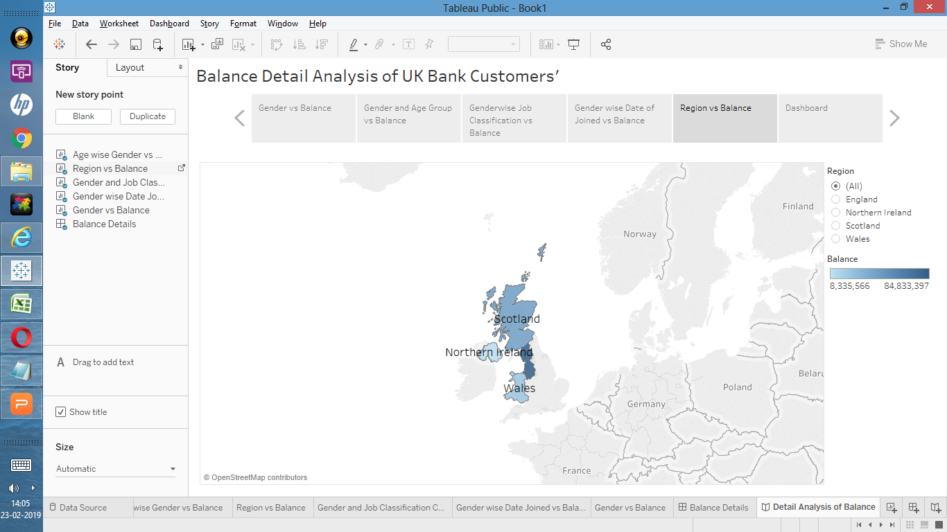
Story line(Region vs Balance)

